Slide 1
Incentives in Blockchain system
《Game Theory》Group Presentation
Jiahao Yao, Junhao Dai
2024.6.4

Slide 2
Overview
Blockchain Intro
Incentive Mechanism
Selfish Mining AttaSelfish Mining Attackck
Game Theory For Mining
Game Theory For Security

Slide 3
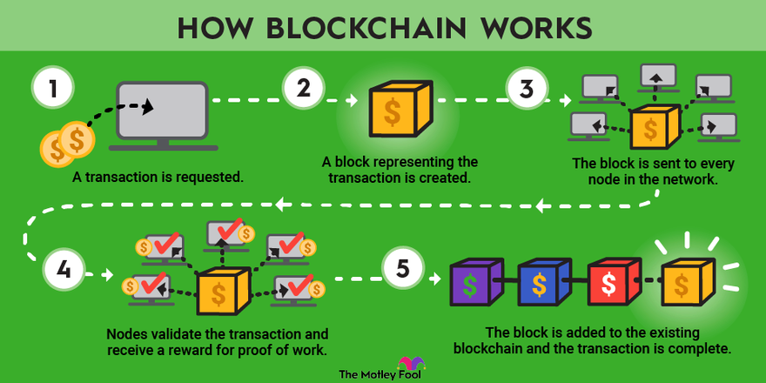
Blockchain Intro
Blockchain is a decentralized, distributed ledger technology that securely records transactions across multiple computers, ensuring data integrity and transparency without the need for a central authority.
Blockchain is a decentralized, distributed ledger technology that securely records transactions across multiple computers, ensuring data integrity and transparency without the need for a central authority.

Slide 4
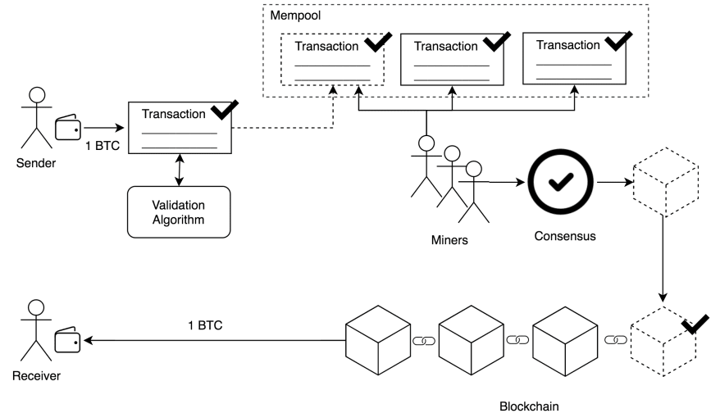

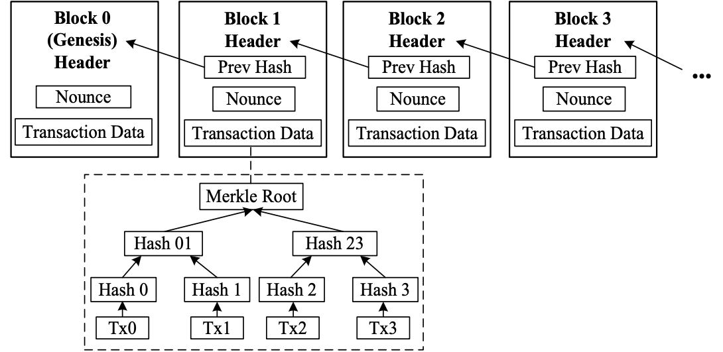
Blockchain Intro
Basic Components：
Transaction
Block
Hash pointer
Merkle Tree

Slide 5
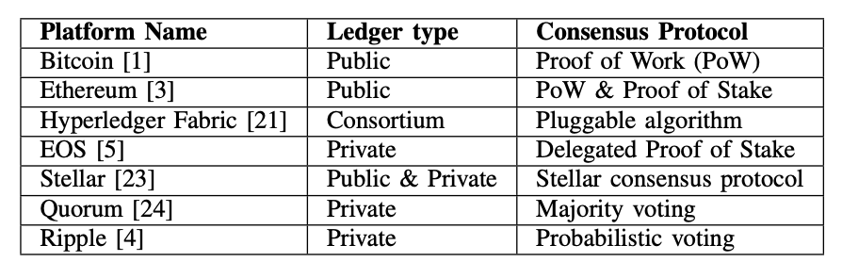
Blockchain Intro
Some Widely-used Blockchain Platforms

Slide 6
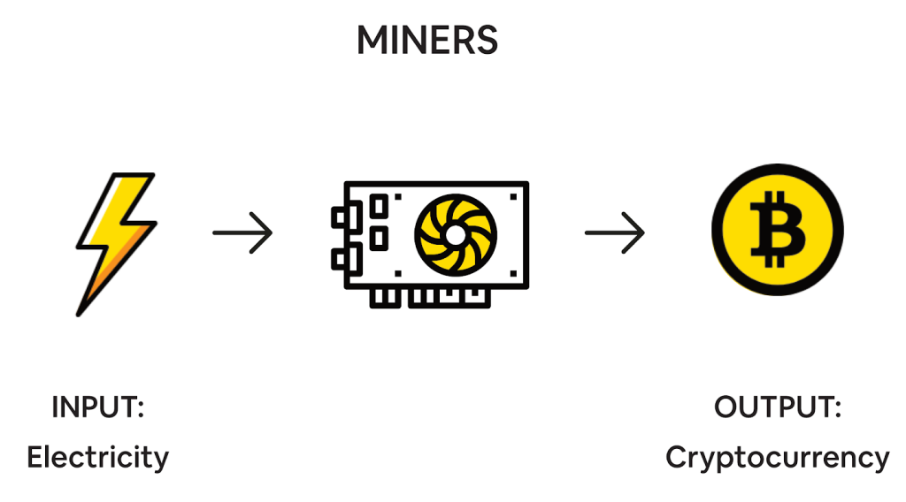
Incentive Mechanism
“ Expending resources to mine gold and inject it into circulation”
Objective
• To ensure all participants are motivated to maintain and secure the network.
• Incentives are crucial for the healthy operation and security of the blockchain.
Objective
To ensure all participants are motivated to maintain and secure the network.
Importance
Essential for the prevention of fraudulent activities and ensuring fidelity and security.
Agreement
Participants are rewarded for contributing computational power.
Types
Mining Rewards: Reward miners for validating transactions and securing the blockchain.
Transaction Fees: Fees paid by users to have their transactions included in the blockchain.

Slide 7
Game Theory For Mining
Three challenges and Game Theory Approach for minig
Objective
• To ensure all participants are motivated to maintain and secure the network.
• Incentives are crucial for the healthy operation and security of the blockchain.
1. Computational Power Allocation
- Challenge: inding the right amount of resources to deploy for maximum efficiency and profit.
- Game Theory Approach: Miners optimize the cost-benefit ratio of resource use to maximize returns.
2. Reward Allocation
- Challenge: Distributing rewards to motivate ongoing participation and honesty.
- Game Theory Approach: Design reward systems that encourage cooperation and align miner incentives with network health.
3. Pool Selection
- Challenge: Selecting a mining pool that maximizes rewards, reliability, and overall returns.
- Game Theory Approach: Miners choose pools based on the best projected earnings and stability.
Solo, PPS, PPLNS...

Slide 8
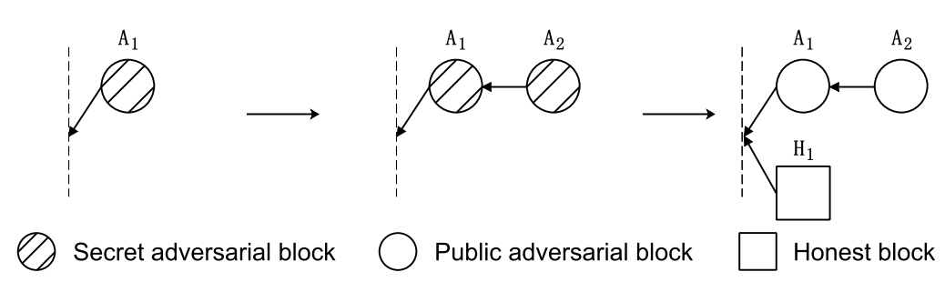
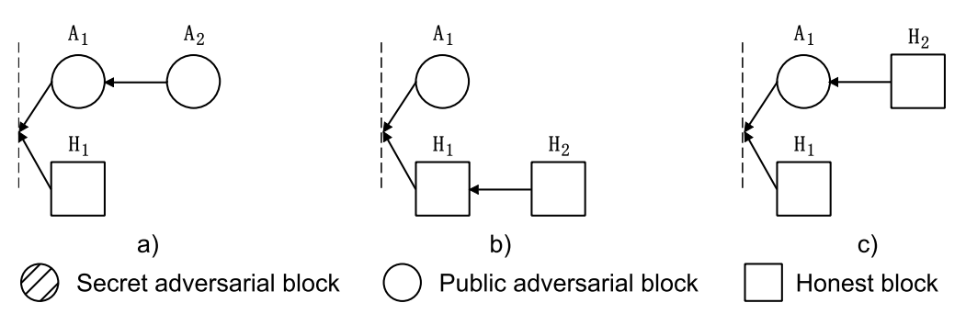
Game Theory For Security
Selfish Mining in Bitcoin

Slide 9
Game Theory For Security
A2 Mining on A1
The selfish miners produce the next blocks A2 after their block and publish it. By LCR, all selfish miners’ blocks are accepted by honest miners, whereas honest block H1 is abandoned.
H2 Mining on H1
Some honest miners produce the next block H2 after the previous honest block H1. If the selfish miners accept these two honest blocks H1 and H2 and mine after them, its block A1 will be abandoned.
H2 Mining on A1
Some honest miners produce the next block H2 after the selfish miners’ block A1. Both blocks A1 and H2 will be accepted, whereas the block H1 will be abandoned by LCR.
Objective
• To ensure all participants are motivated to maintain and secure the network.
• Incentives are crucial for the healthy operation and security of the blockchain.
fraction of computation power owned by the selfish miners
fraction of honest computation power working on the selfish miners’ blocks
the relative revenue for the selfish miner
selfish miner can obtain a revenue larger than its honest mining when:

Slide 10
Game Theory For Security
The Pool Game of Selfish Mining
Objective
• To ensure all participants are motivated to maintain and secure the network.
• Incentives are crucial for the healthy operation and security of the blockchain.
the number of miners loyal to pool i
the number of miners from pool i that infiltrate pool j at step t.
The average time to find a solution is proportional to its hash rate or mining power.
Block discard is random, factor this event into the probability of finding a block.
A mining pool is a group of miners who share revenue in proportion to their computing power.
Block withholding is an attack launched by mining pool members against other mining pools.
the direct mining rate of pool i at step t :
the revenue density of pool i at end of step t :

Slide 11
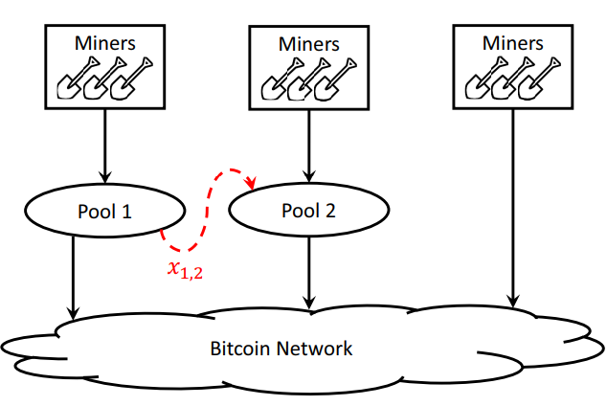
Game Theory For Security
One Attacker
To find the optimal permeability, we need to calculate

Slide 12
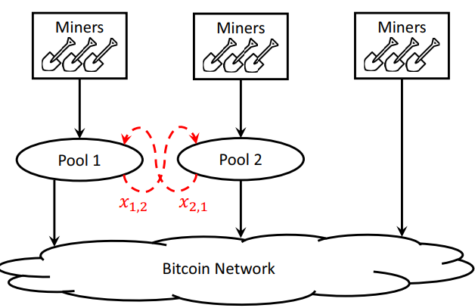
Game Theory For Security
Two Pools
No attack is not an equilibrium point, Nash equilibrium exists and satisfies :

Slide 13
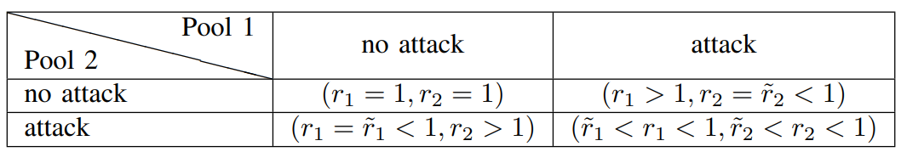
Game Theory For Security
Two Pools
q Identical Pools

Slide 14
Division of Work
Objective
• To ensure all participants are motivated to maintain and secure the network.
• Incentives are crucial for the healthy operation and security of the blockchain.
Jiahao Yao:
Game Theory For Mining in blockchain
Junhao Dai:
Game Theory For Security in blockchain

Slide 15
Thanks

